Slide 1
Module – 4 Metaphors and Prototyping
Metaphor method: Theory and methodology of concept generation,
Blend method & Thematic Method.
Articulating design ideas: Storytelling;
Introduction to Sketching & Dynamic Diagrams;
K Scripts,
Introduction to Prototyping & Visualization Design Tools

Slide 2

‘For me design is a question mark.
That is how I start every new project.’
Gijs Bakker, 2007
(Dutch jewellery designer)

Slide 3
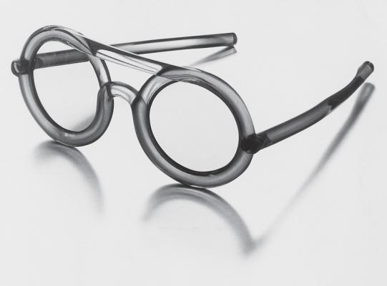
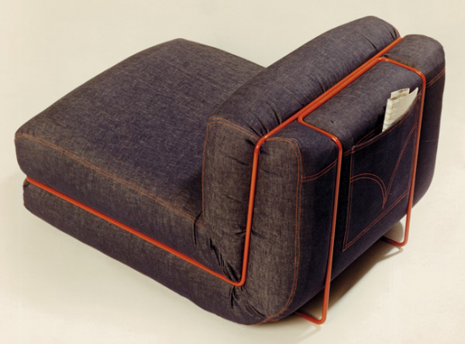
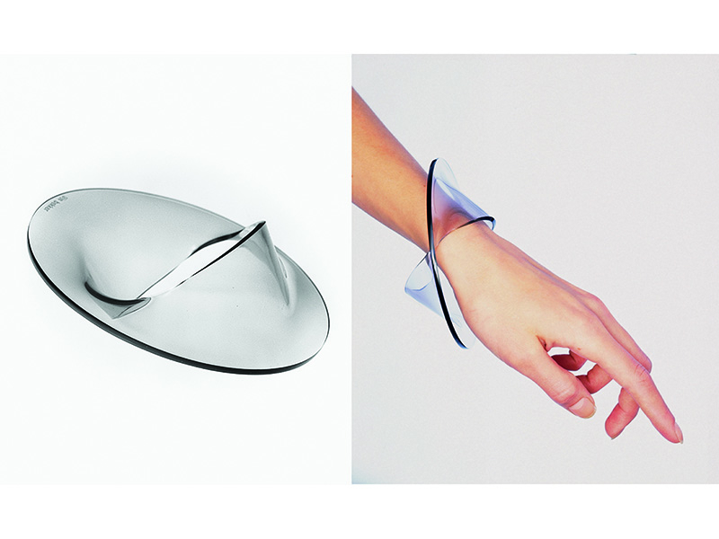
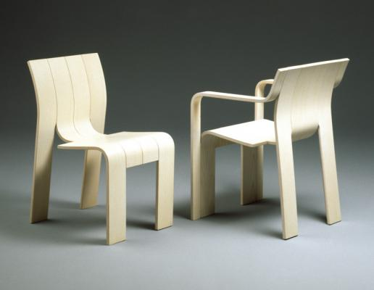
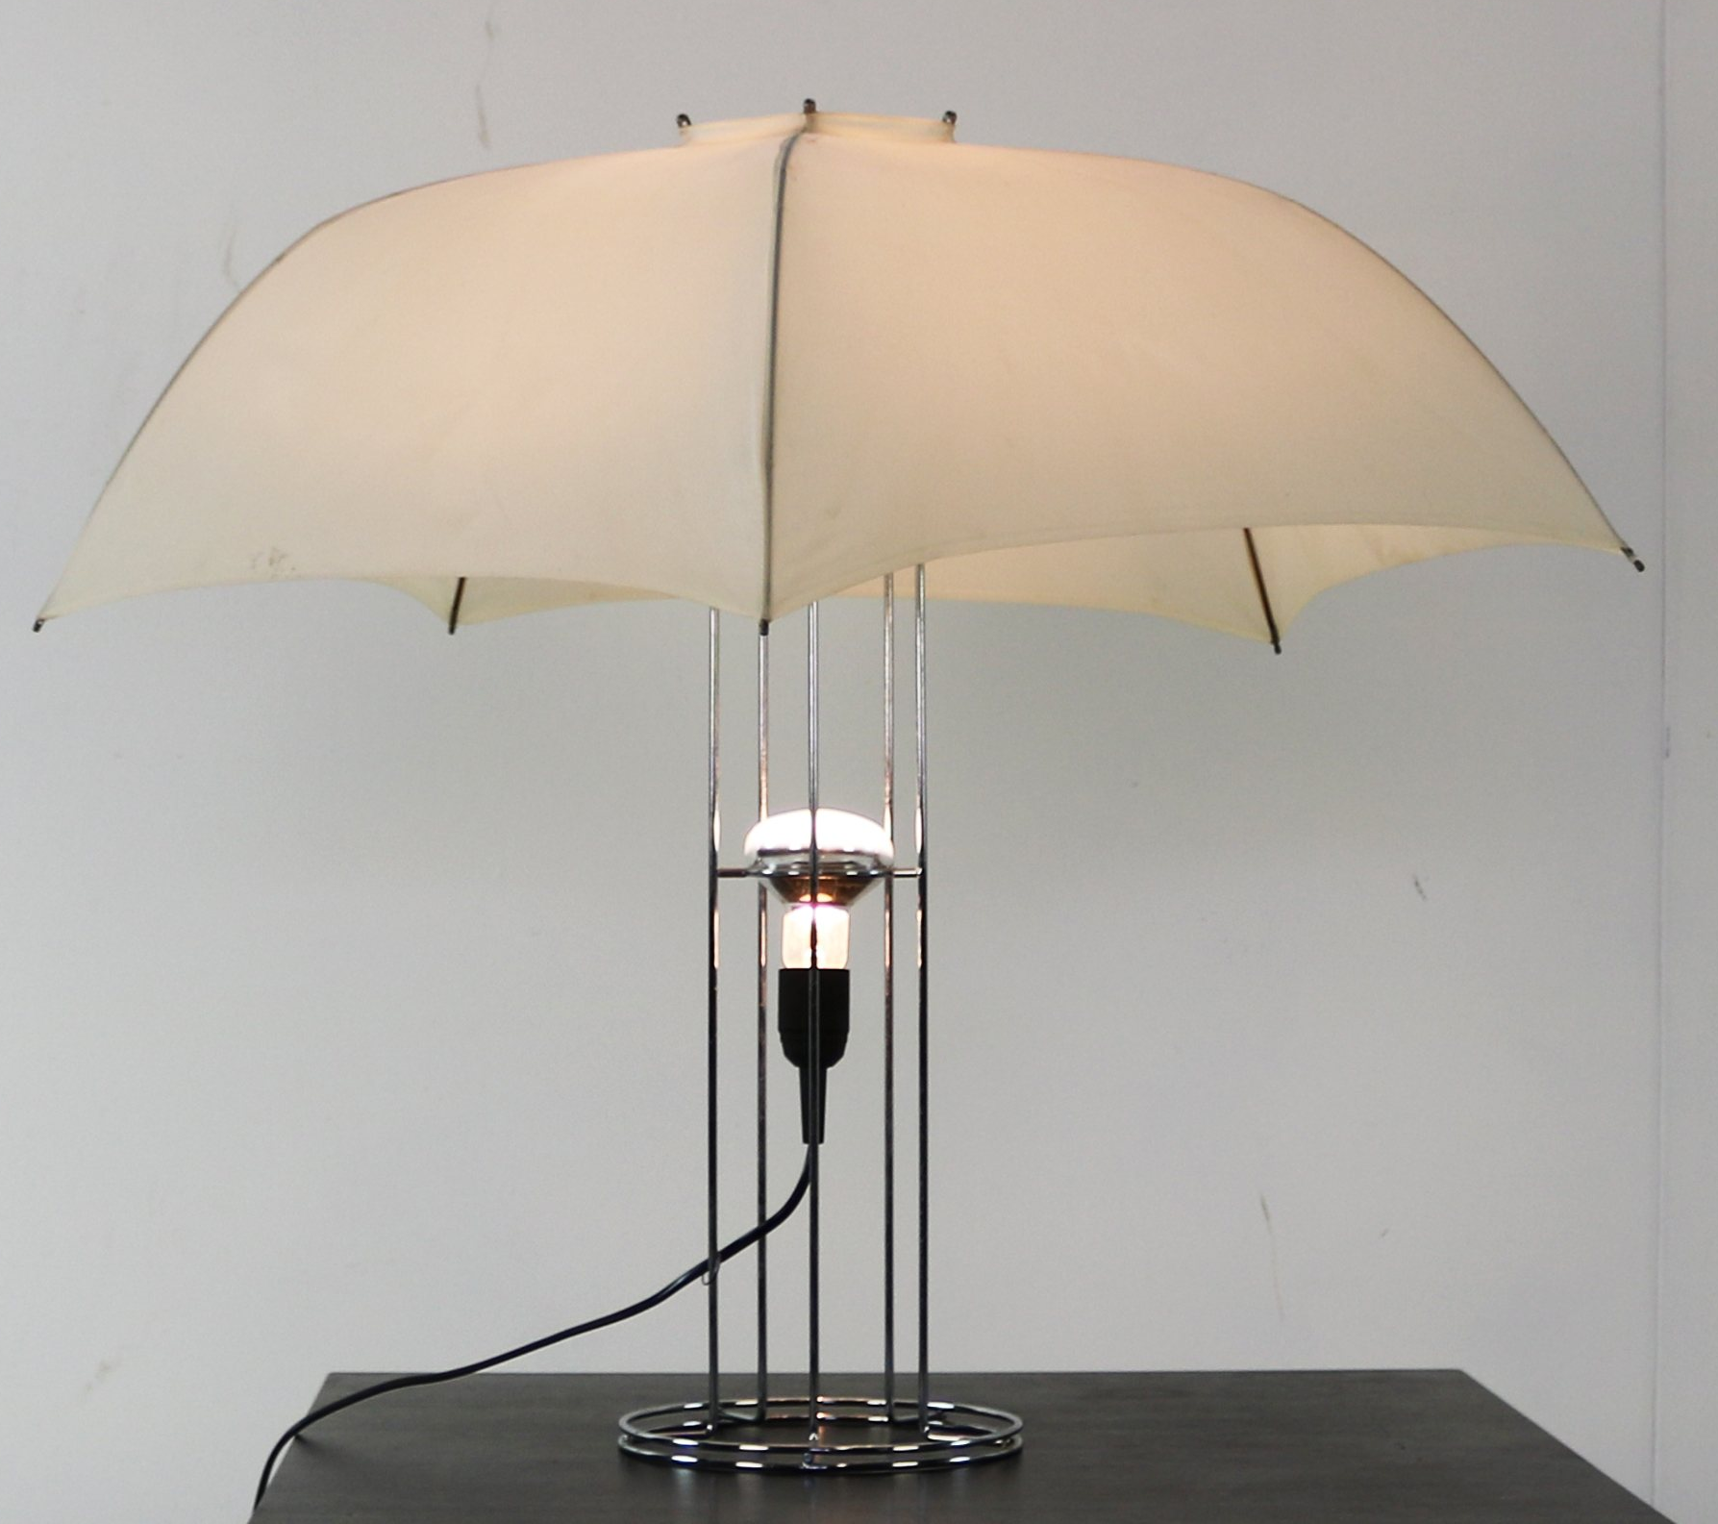
Few products designed by Mr. Bakker

Slide 4
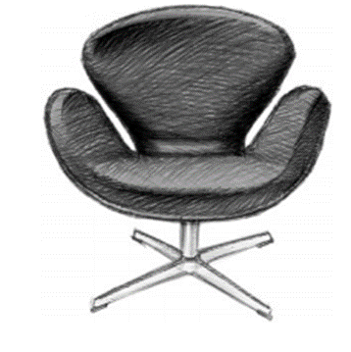
Metaphor Method in Concept generation
A metaphor is a rhetorical figure representing one concept by way of another concept, which is considered similar to the concept to be represented. Metaphors are often used in design.
For example, in the figure shows a famous chair called the Swan Chair. This chair was created by the Danish designer Arne Jacobsen for a hotel, and it remains very popular. As its name conveys, the Swan Chair is a chair which approximates the shape of a swan in order to convey the quality of a swan (i.e. elegance) and can be represented by the framework for a metaphor, such as ‘the chair is a swan’

Slide 5
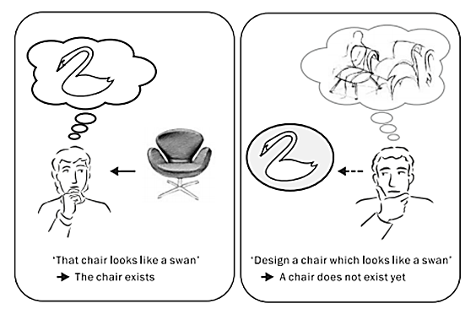
Types of Metaphors
If a person says “that chair looks like a swan”
when he or she looks at the chair, it refers to an existing chair in the picture. On the other hand, if a person says this while he or she is designing the chair, then the chair is a concept which does not yet exist.
In this situation, ‘the new chair which is to be designed is a swan’ is a more suitable representation. In such a case, the similarity (implicit common features; e.g. elegant shape) between the chair and a swan play an important role. On the basis of the above considerations, we can say that, in the design process using metaphors, a new concept will be generated which will be similar to the concept to be assimilated to. A new concept of a chair is generated (referring to a swan or imitating a swan) on the basis of the similarity between the chair to be designed and a swan.
“First order Concept generation”

Slide 6
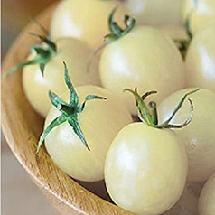
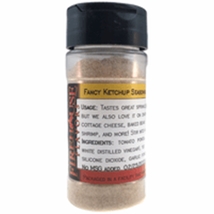
Higher Order Concept Generation
A first-order concept generation is useful only to create a subspecies of an existing object, since it cannot extend beyond the category of the existing product.
Abstract concept generated by combining multiple abstract concepts is called a high-order abstract concept, and the high-order concept generation is the process of generating a new concept on the basis of this high-order abstract concept.
Difference between “White Tomato” and “Powdered Ketchup”
A high-order concept generation is understood to have its basis on the dissimilarity-recognition process.

Slide 7
Blending and Thematic Method
High-order abstract concepts can be interpreted as abstract concepts involving an innovative concept which inherits partial properties from both the two base concepts but is different from the two base concepts. We define the concept generation based on this process as concept blending or blending method.
The concept of ‘‘powdered ketchup’’ is an example of concept blending. This new concept is understood to be generated by blending the different properties of snow (abstract concept: snowflake) and tomato (abstract concept: flavouring).
On the other hand, according to the latter relation between the two base concepts, high-order abstract concepts can be interpreted as abstract concepts involving an innovative concept which is generated from the thematic scenes (situations, roles, etc.) of the base concepts. We define the concept generation based on the thematic relation as concept integration in thematic relation.

Slide 8
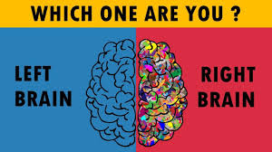

Slide 9


Slide 10
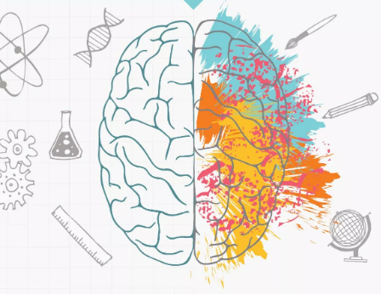

Slide 11
CREATIVITY AND PROBLEM SOLVING
Creative thinkers are distinguished by their ability to synthesize new combinations of ideas and concepts into meaningful and useful forms.
A creative engineer is one who produces a lot of ideas. These can be completely original ideas inspired by a discovery. More often, creative ideas result from putting existing ideas together in novel ways.
A creative person is adept at breaking an idea down to take a fresh look at its parts, or in making connections between the current problem and seemingly unrelated observations or facts.
We all like to be called “creative,” yet most of us, in our ignorance of the subject, feel that creativity is reserved for only the gifted few.
There is the popular myth that creative ideas arrive with flash-like spontaneity—the flash of lightning and clap of thunder routine.

Slide 12
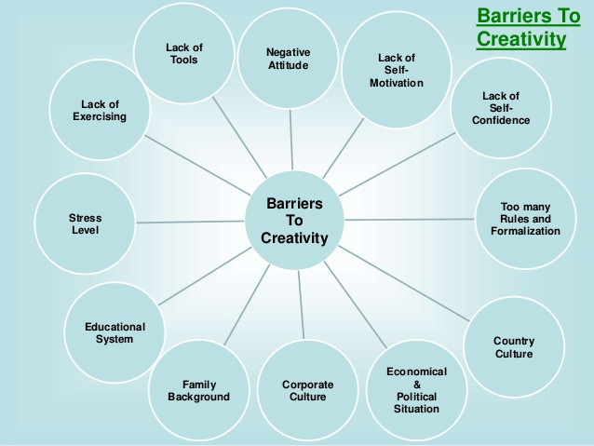
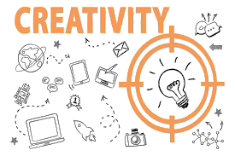
Aids to Creative Thinking
Develop a creative attitude
Unlock your imagination
Be persistent
Develop an open mind
Suspend your judgment
Set problem boundaries

Slide 13

Communication

Slide 14
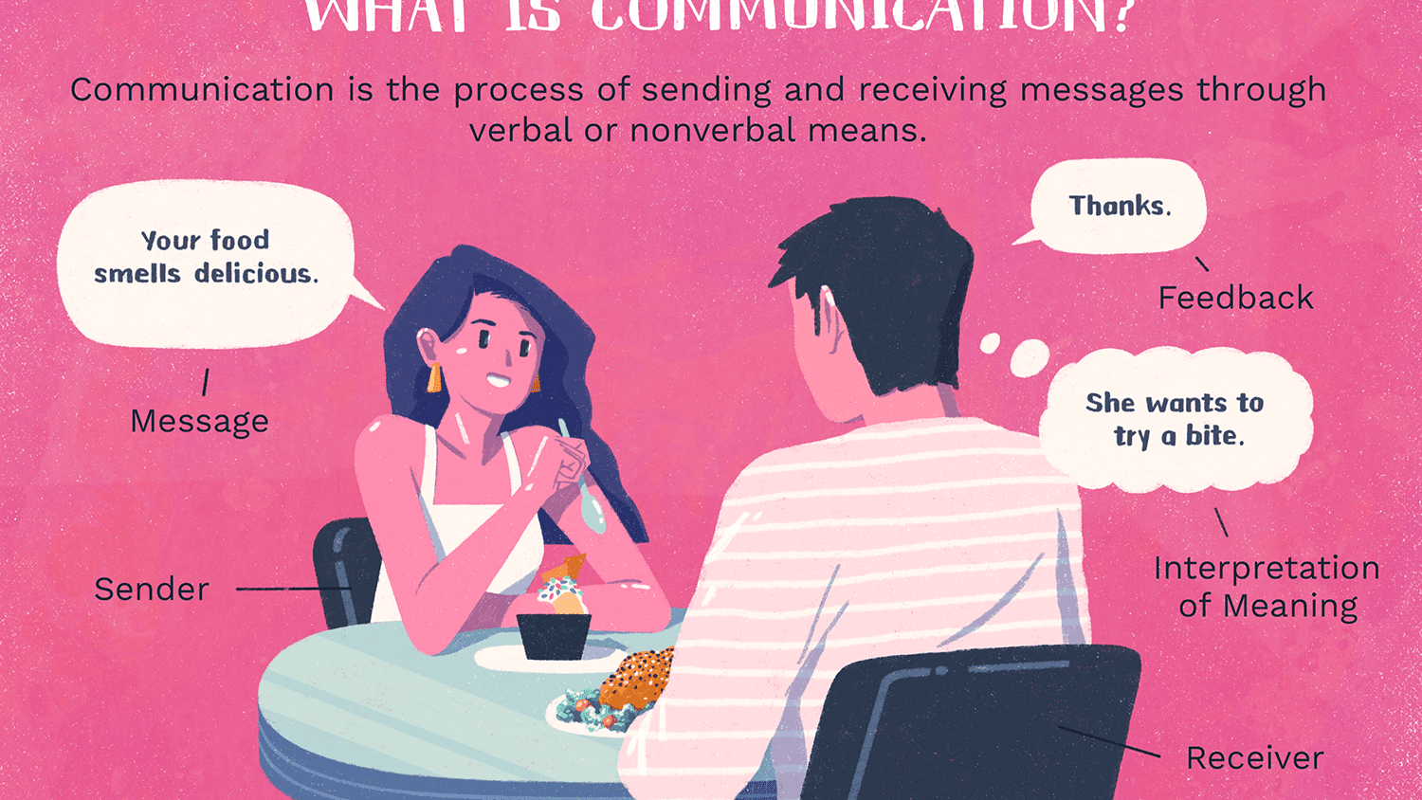
What is Communication ?

Slide 15
Articulate Design Ideas
At the surface this sounds easy – anyone can talk, but talking isn't the challenge. The challenge is in communicating well.
How can you communicate in a way that convinces your stakeholder(s) that this is the problem to focus on? The meaning behind a particular decision? The goal you're trying to achieve?
Knowing the goal is critical, but keep in mind that the goal can change.
As we progress through the design process, new insights arise which can influence the goal or direction of the project.

Slide 16
Articulate Design Ideas
A big part of any designers job is to convincing others of our design can be key to success.
Being a designer we need to consider consumers needs and values. This can be helpful in pinpointing what to focus on.
For example:
As an engineer, I value technical constraints and want to know the technicality required to make this project successful, so I should focus on how to address these.
As a product owner I value business goals and want to know how this is solving the business problem, so I should ensure that I outline how this solution will achieve that.
Equally important as understanding their needs and values is listening.
Listening helps to uncover the real problem and let others be heard.

Slide 17
Defining Designs' Purpose
Solve a problem
What problem does this particular design solve? Always refer to the problem, goals and big picture.
2. Be easy for users
How does this particular design affect the user? What barriers are we creating or minimizing?
3. Be supported by everyone
There will always be someone who will challenge your decision. Be prepared to explain why it's better than the alternative and the other directions you explored.

Slide 18
Documentation Benefits in Articulate Design
Avoids repeat conversations
Focuses on being articulate
Builds trust with stakeholders
Keeps the meeting on track

Slide 19
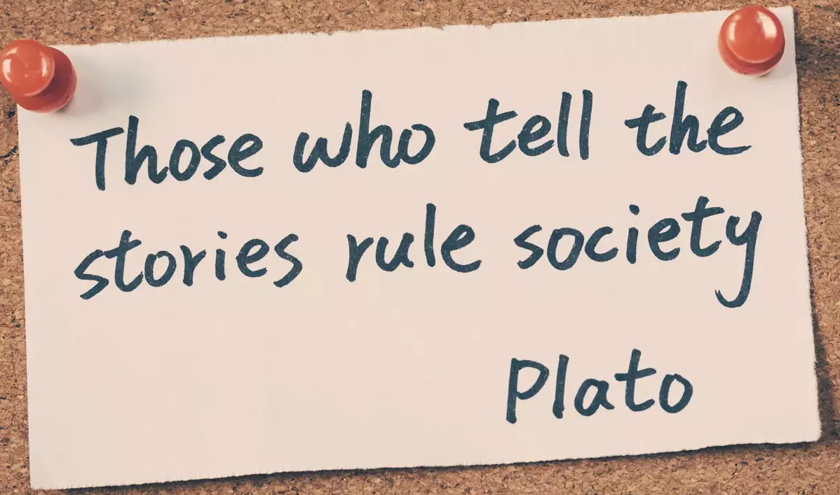

Slide 20
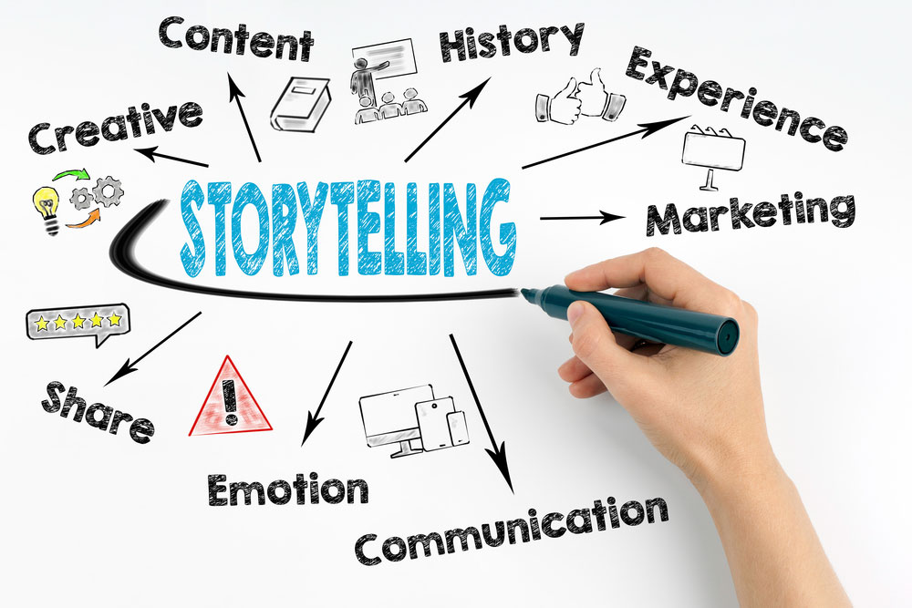

Storytelling is a powerful communication tool

Slide 21
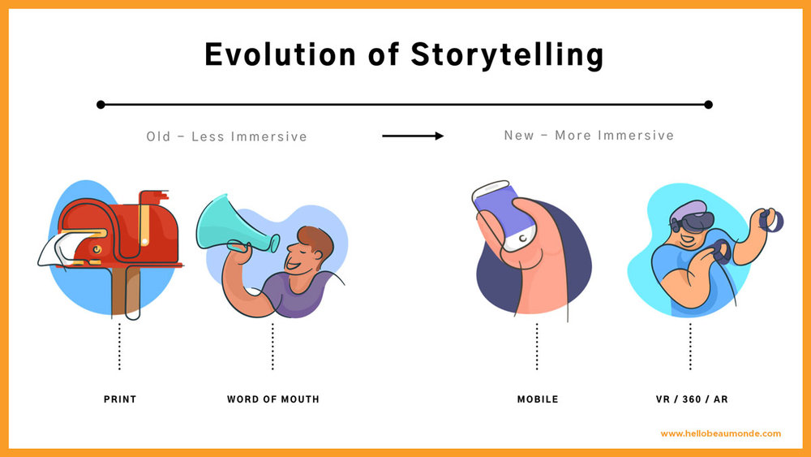

Slide 22

Storytelling
Storytelling is used in design as a technique to get insight into users, build empathy and access them emotionally. With stories, designers speak via character, theme, melody, and spectacle to increase the appeal of what they offer and provide a solid understanding of the users.
Seven Elements in Storytelling
Plot – what are users trying to achieve/overcome?
Character – who are the users: not just
demographically, but what insights do you require to
understand what they’re truly like?

Slide 23

Storytelling
Theme – how can you establish a trustworthy presence to them?
Diction – what will your design say to users and how?
Melody – will the overall design pattern appear pleasant and predictable to users, moving them emotionally?
Décor – how will you present everything so the graphics match the setting the users can sense?
Spectacle – how can you make your design outstanding so users will remember it?

Slide 24
Six Rules in Storytelling
Self knowledge and awareness
Clear structure and purpose
Have a character to root
Appeal to our deepest emotions
Surprising and unexpected
Simple and focused

Slide 25
Sketching
A sketch is a rapidly executed freehand drawing that is not usually intended as a finished work. A sketch may serve a number of purposes: it might record something that the artist sees, it might record or develop an idea for later use or it might be used as a quick way of graphically demonstrating an image, idea or principle.
Sketches can be made in any drawing medium. The term is most often applied to graphic work executed in a dry medium such as silverpoint, graphite, pencil, charcoal or pastel. It may also apply to drawings executed in pen and ink, digital input such as a digital pen, ballpoint pen, marker pen, water colour and oil paint. The latter two are generally referred to as "water colour sketches" and "oil sketches". A sculptor might model three-dimensional sketches in clay, plasticine or wax.

Slide 26
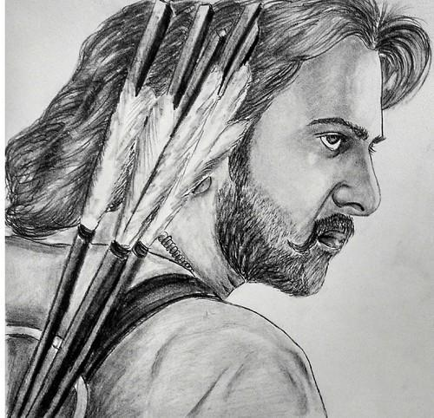
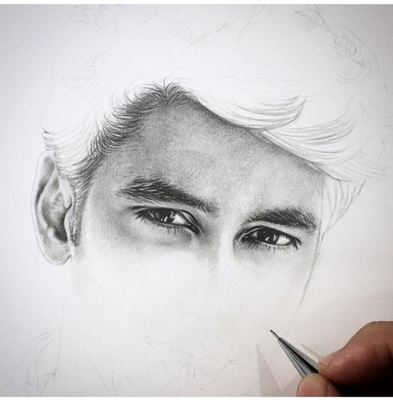
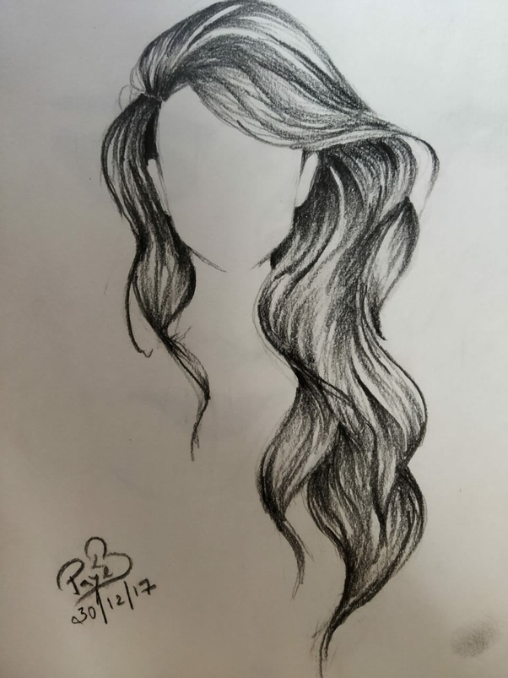
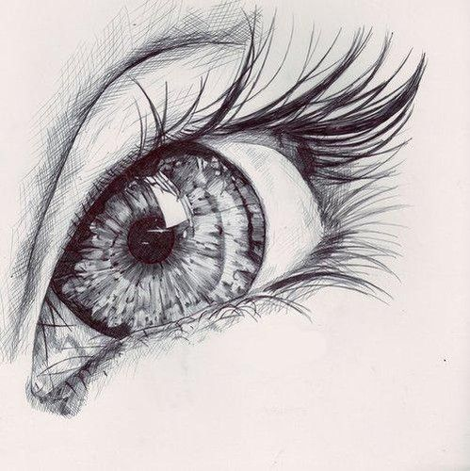

Slide 27
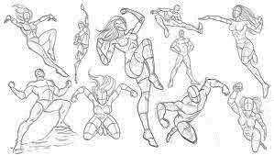
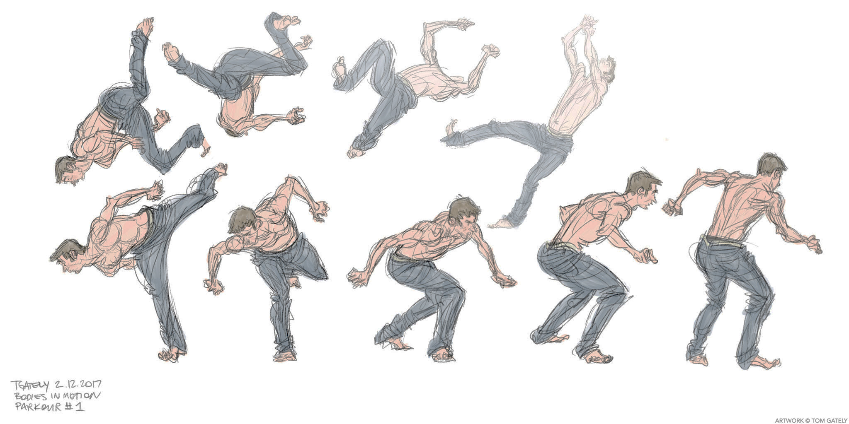
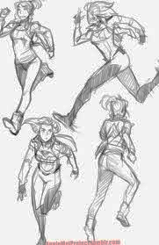
Dynamic drawings

Slide 28
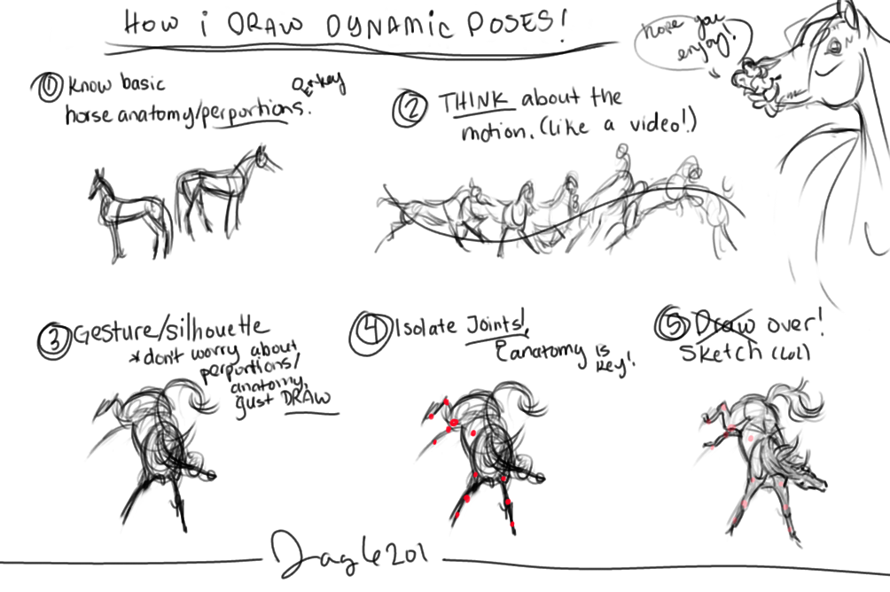

Slide 29
K - Script
https://medium.com/@bladekotelly/k-scripts-the-fastest-and-most-flexible-way-to-articulate-a-user-experience-97264d9c4786

Slide 30
What is a k-script ?
The fastest and most flexible way to articulate a user experience
Blade Kotelly
UX Design Strategist, Consultant, Educator

Slide 31
Introduction
In designing physical products, sketching is commonly used as a quick and inexpensive method to allow the designer to express an idea quickly, evaluate the concept, and explain it to others.
Early sketches (which really are a form of prototyping) can be easily tweaked, changed wholesale, edited, questioned or improved.
In the late 90s Mr. Kotelley realized that there was a need for UX designers to have a method to scketch — and he created a tool name “K-Scripts”.
He started to apply this same idea to web design, mobile application design, social-robot interaction design, and teaching it in his design-thinking class at MIT. Since then, it has been used at numerous organizations including big ones like Adobe and the U.S. Air Force, for articulating interactive experiences for software, hardware, robotics and a whole lot more.

Slide 32
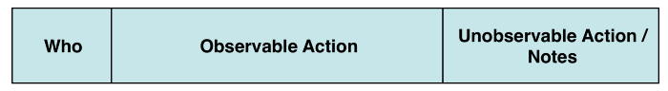
How To Make A K-Script
K-Scripts are valuable when they focus on the 80% case — the most typical cases that users will encounter. They can also be used for failure conditions (in which a user may make mistakes, even if we don’t expect to have it happen often) or any other context — but the best value is to show off a normal interaction and not a possible, but unlikely one.
The format of the K-Script can be elegant and visually designed, or as simple as a spreadsheet table. Regardless of the format used, all K-Scripts contain three essential elements:

Slide 33
Who:
The first section defines the actor, whomever is performing the action, and shows the sequential relationship between a user (or users) and the product. The who could be a generic person, a specific user, a product, a system or any entity that is involved in the interaction.
Observable Action:
This section describes an action that a user performs or an action that occurs by a system — as long as it’s something a viewer could observe. Whether it is discussing a physical interaction (touching a screen, walking down stairs) or a verbal one (talking to a machine), a detailed and truthful description matters here; the What section is what enables the reader to create a mental picture of the interaction.
Unobservable Action:
This is the section that enables a designer to help the reader understand why a situation may be occurring (motivation of the user, or notes about how the system or technology works to enable this interaction.) It’s also a good place for others to pose questions about the interaction.

Slide 34
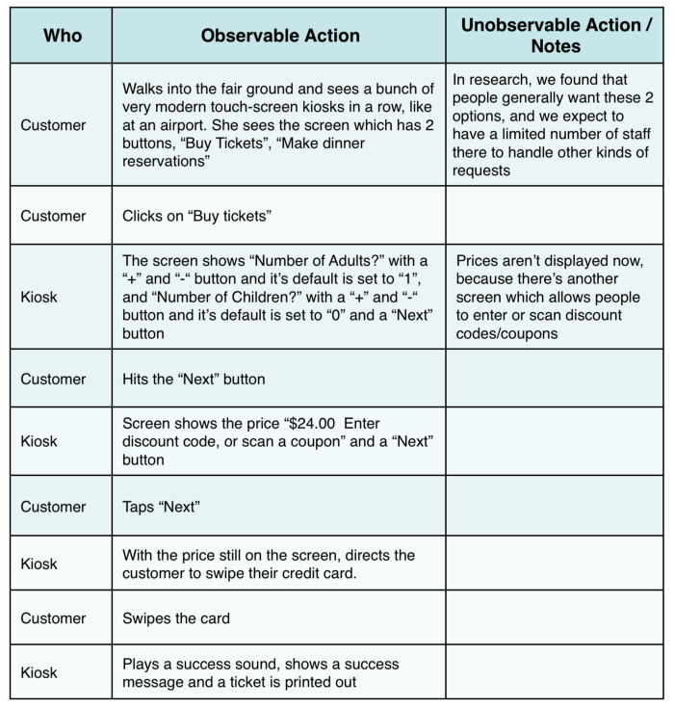
Example: A Basic K-Script
Let’s take a look at a short K-Script for the design of a new ticketing kiosk at a large fair:
K-Scripts are an exceptionally easy thing to construct — and it would take a lot longer to sketch it out visually. The K-Script format also allows someone else to edit and provide feedback:

Slide 35
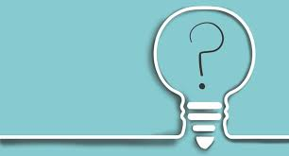
When to use a K-Script ?
The ability to K-Scripts up quickly is what makes them a powerful tool early on in the design process.
A K-Script is a great way to introduce a new idea, as it can provide a clear picture of the interaction to those who have no familiarity with the product, but it can also be useful throughout the entire design process.
Just as they function as an easy way to convey basic functionality, they can constantly be refined and become more robust (and more complete) over time, while still maintaining their flexibility.
In addition to their use as a resource for the designer during product development, K-Scripts can also be used to demonstrate functionality to clients or investors.

Slide 36
When to use a K-Script ?
By combining a thorough and well-developed K-Script with a rudimentary prototype, customers can experience the feel of the system (through a functional prototype) as well as understand the depth and complexity at which the final system will operate.
And since it’s text and it’s focused on the user experience, anyone with a little understanding of the context will be able to understand it — even non-designers.
Since K-Scripts are not meant to be all encompassing it’s not necessary to create convoluted and overly complex scripts. The better use is to have the script focus on typical interactions and use more detailed logic diagrams to show non-typical interactions.
However, additional K-Scripts should be created for less common or fringe cases when the script format is the best way to express the idea. A set of K-scripts creates a holistic view of the system that can communicate to lots of different groups and provide vision that aligns teams.

Slide 37
Rapid Prototyping

Slide 38
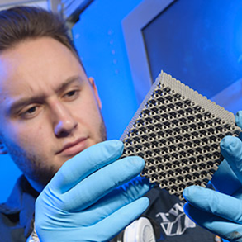
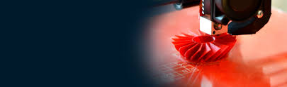
Rapid Prototyping
Rapid prototyping is the fast fabrication of a physical part, model or assembly using 3D computer aided design (CAD).
The creation of the part, model or assembly is usually completed using additive manufacturing, or more commonly known as 3D printing.
How Does Rapid Prototyping Work?
Rapid prototyping (RP) includes a variety of manufacturing technologies, although most utilize layered additive manufacturing.
While additive manufacturing is the most common RP process, other more conventional processes can also be used to create prototypes.

Slide 39
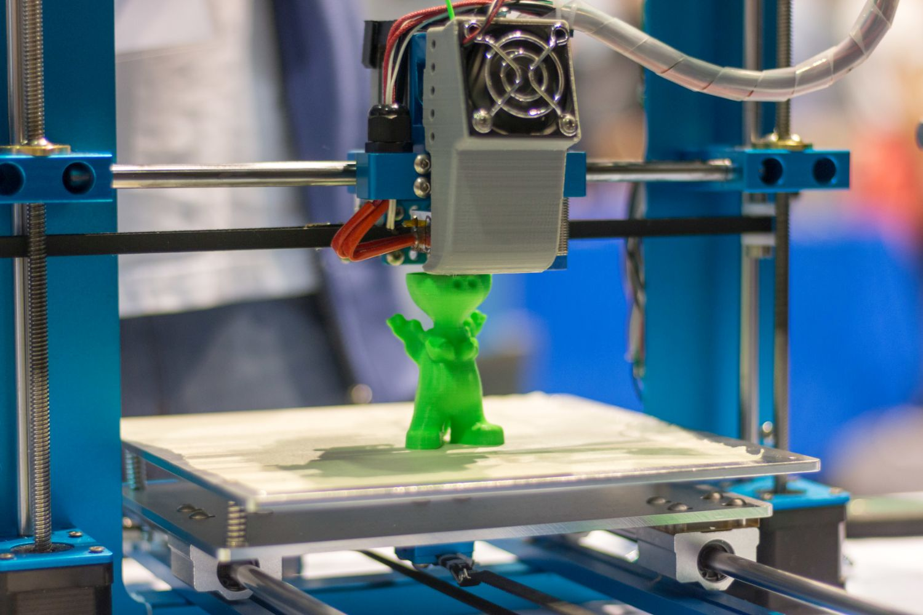
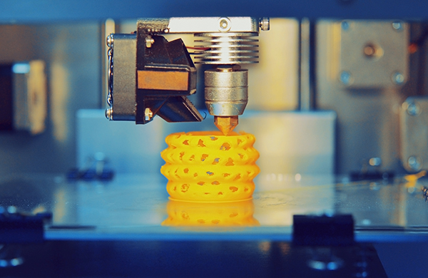
Rapid Prototyping
These processes include:
Subtractive: whereby a block of material is carved to produce the desired shape using milling, grinding or turning.
Compressive: whereby a semi-solid or liquid material is forced into the desired shape before being solidified, such as with casting, compressive sintering or molding.

Slide 40
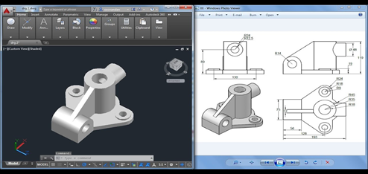
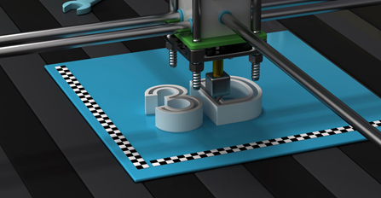
Additive Rapid prototyping -3D printing
One type of Rapid Prototyping is known as 3D printing, which is an additive manufacturing technology.
The process begins with taking a virtual design from modeling or CAD software.
The 3D printing machine reads the data from the CAD drawing and lays down successive layers of liquid, powder, or sheet material, and builds up the physical model from a series of cross sections.
These layers, which correspond to the virtual cross section from the CAD model, are automatically joined together to create the final shape.

Slide 41
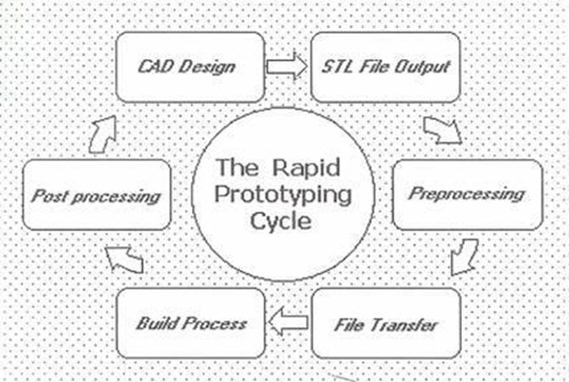
RP process

Slide 42
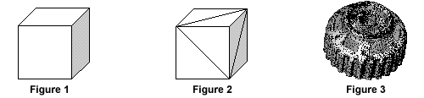
STL file
The STL file format has become the Rapid Prototyping industry's defacto standard data transmission format, and is the format required to interact with On Demand Manufacturing.
For a simple model such as the box shown in figure 1, its surfaces can be approximated with twelve triangles, as shown in figure 2. The more complex the surface, the more triangles produced, as shown in figure 3.

Slide 43
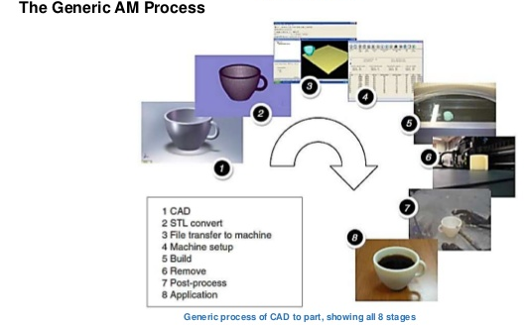
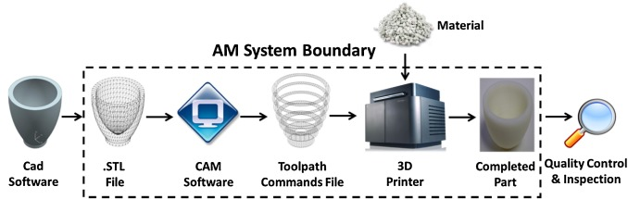

Slide 44
Prototyping Tools for Designer
Adaptation: Always choose a tool that you can easily analyse and adapt.
Sharing: As we know, teamwork is essential for a great design work, so check your tool is suitable for collaboration to be in sync with other members of your team.
Usage: When selecting a prototyping tool, always check how well it fits with your design process and other tools you regularly use
Easiness of Use and Comfort: The ease of use in using the prototyping tool is essential for the designer to save time and help increase output.
Price: we should be careful while choosing tools and not be blinded by the features.
In simple terms prototyping tools allow designers to experience how their project will work when it will get completed.
There are different types of prototypes tools or UX design tools open source available with different goals and users, means the similar prototyping tool would not work every time.
How to Prefer Best Prototyping Tools that Suit Your Needs?
In order to pick a right tool from the variety of online prototyping tools for designing, here are few factors that will assist you in your research.

Slide 45
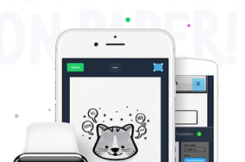
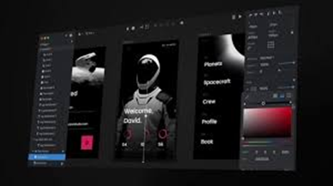
Available E-tools
Marvelapp — Turn anything into interactive prototypes
InVision — Powerful design prototyping tools

Slide 46
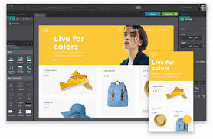
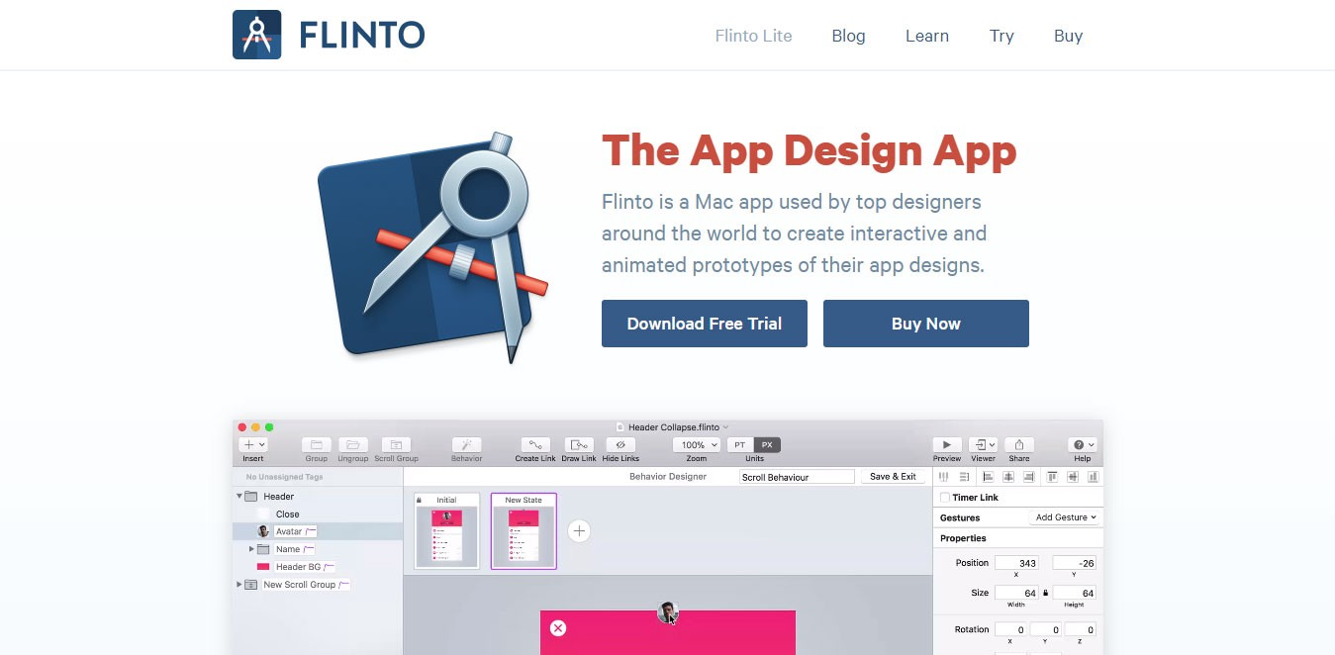
Available E-tools
Justin mind — Prototyping Tool for web and mobile apps
Flinto — The App Design Apps

Slide 47
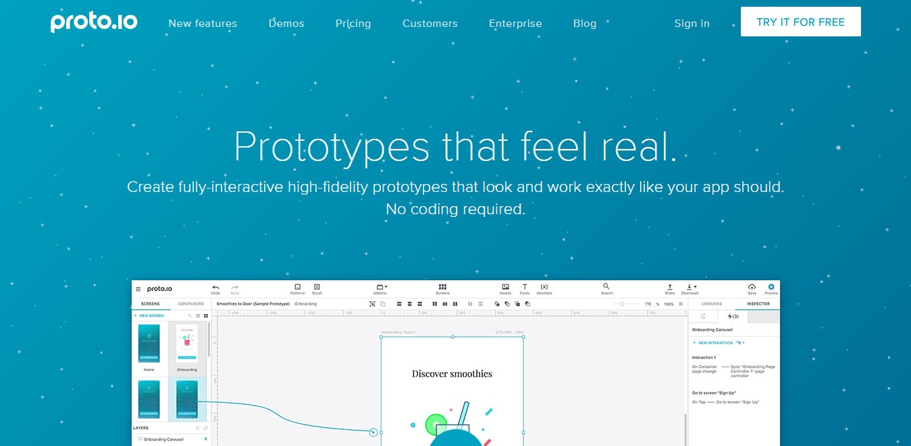
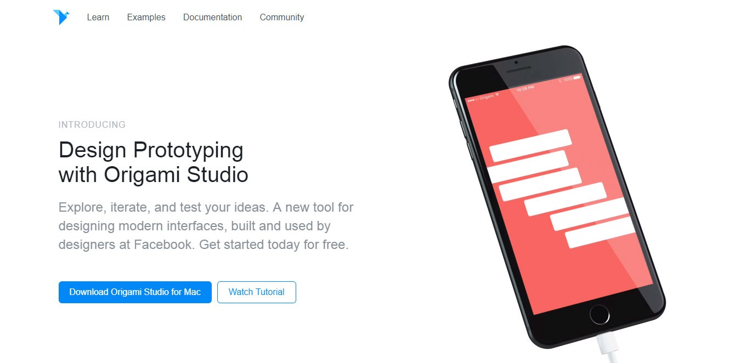
Available E-tools
Proto.io — Prototypes that feel real
Origami.Design — Design Prototyping

Slide 48
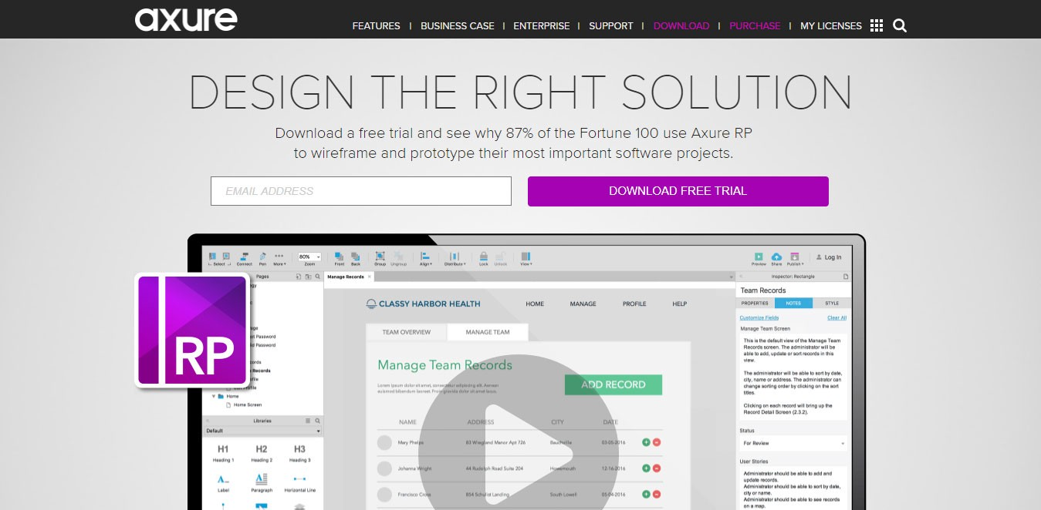
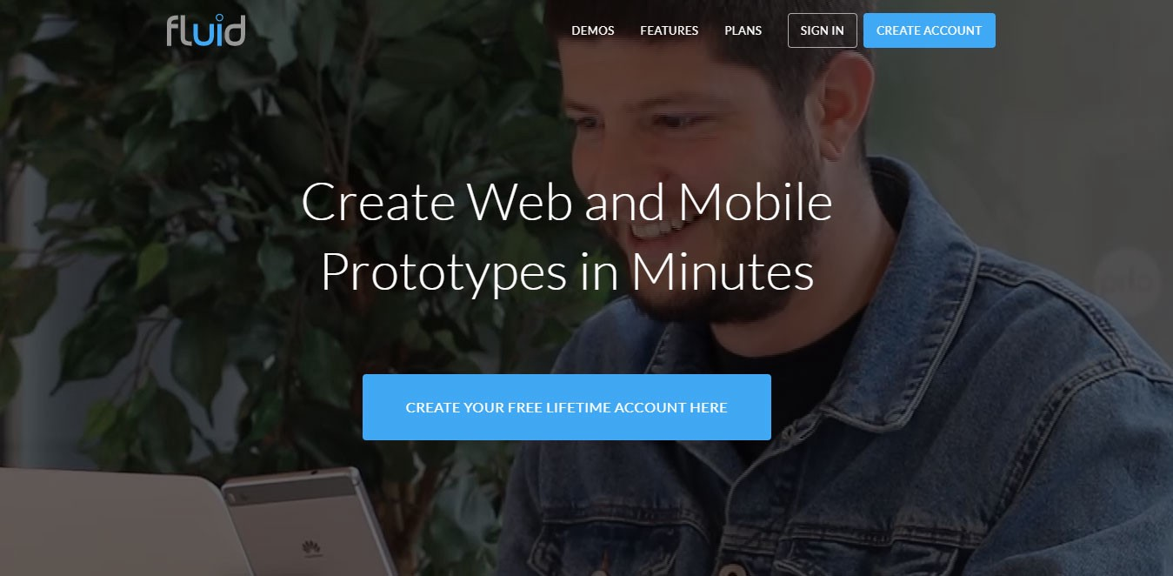
Available E-tools
Axure — Design the right solution
Fluid — Create Web and Mobile Prototypes in Minutes

Slide 49
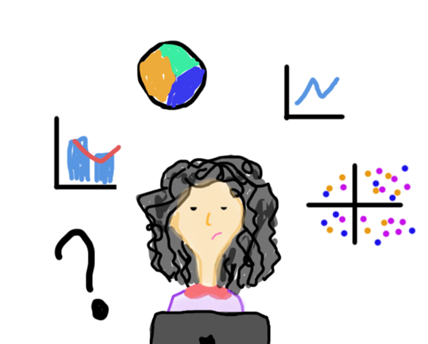
Design Tools for Data Visualization
Adobe Illustrator
SketchApp
Balsamiq
Adobe After Effects
Origami Studio
Adobe Experience Design
Craft
Microsoft PowerPoint

Slide 50
